Slide 1
File Systems Unfit as Distributed Storage Backends: Lessons from 10 Years of Ceph Evolution
Abutalib Aghayev, Sage Weil., Michael Kuchnik., Mark Nelson, Gregory R. Ganger
SOSP ’19
Presenter: 이영재
2021. 02. 02
leeyoungje@naver.com

Slide 2
Introduction & background
Bluestore
Evaluation
Challenge
Conclusion

Slide 3
1. Introduction & Background
Storage backend History
EBOFS / objectstore
Btrfs, XFS / filestore
WAL Implement
NewStore

Slide 4
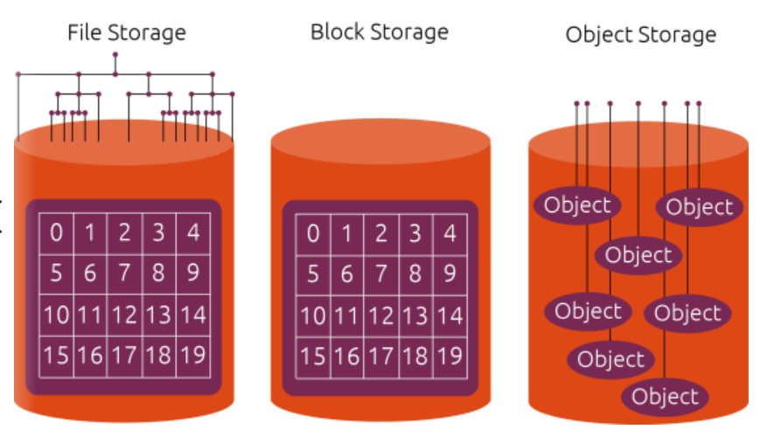
1. Introduction & Background
What is file storage, object storage ?
file storage
Block storage
object storage

Slide 5


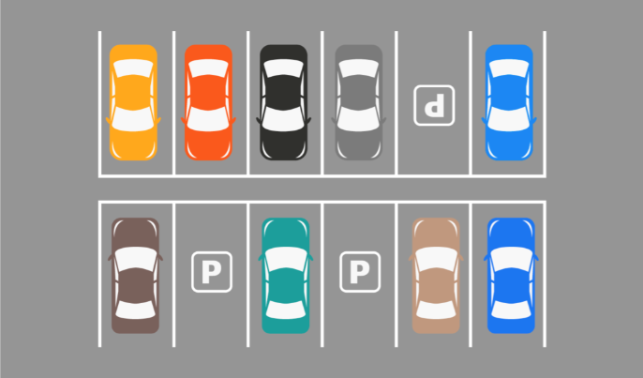
1. Introduction & Background
What is file storage, object storage ?
Block storage
file storage
object storage

Slide 6
1. Introduction & Background
Problems
EBOFS / objectstore
Btrfs, XFS / filestore
WAL Implement
NewStore
Lack transaction, deduplication, checksums, transparent compression

Slide 7
1. Introduction & Background
Problems
EBOFS / objectstore
Btrfs, XFS / filestore
WAL Implement
NewStore
internal transaction mechanism is generally limited, and thus, unavailable to users.
making its internal transaction mechanism available to users through a pair of system calls ➔ commit a partial transaction

Slide 8
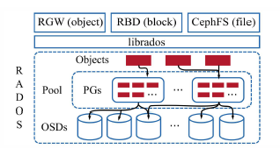
1. Introduction & Background
Problems
EBOFS / objectstore
Btrfs, XFS / filestore
WAL Implement
NewStore
slow directory enumeration (readdir) operations on large directories
Writeback make overhead

Slide 9
1. Introduction & Background
Problems
EBOFS / objectstore
Btrfs, XFS / filestore
WAL Implement
NewStore
Slow Read-Modify-Write
➔ every read-modify-write operation incurred the full latency of the WAL commit, preventing efficient pipelining
Double Writes
➔ the WAL in FileStore is that data is written twice : halving the disk bandwidth

Slide 10
1. Introduction & Background
Problems
EBOFS / objectstore
Btrfs, XFS / filestore
WAL Implement
NewStore
combination of RocksDB and a journaling file system introduces high consistency overhead
➔ fsync in each step should issue two expensive FLUSH CACHE command to disk
creating an object in NewStore results in four expensive flush commands to disk

Slide 11
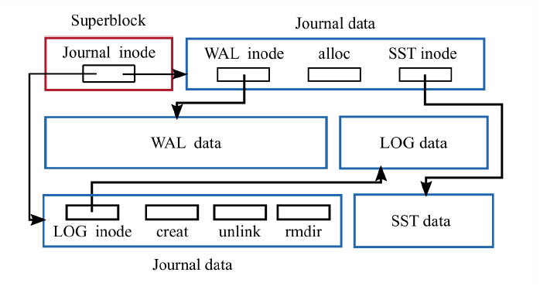
2. BlueStore
BlueStore architecture
Bluestore
BlueStore implements a small, special-purpose interface
BlueStore is implemented in user space
BlueStore’s control of the I/O stack
BlueStore runs directly on raw disks(use direct I/O)
Use BlueFs (design for RocksDB)
metadata
data
RocksDB
Storage Device

Slide 12
2. BlueStore
Enabled by BlueStore
Space-Efficient Checksums
➔ computes a checksum for every write and verifies the checksum on every read
Overwrite of Erasure-Coded Data
➔ makes overwrites practical because its copy-on-write mechanism avoids full physical copies
Transparent Compression
➔ implements transparent compression where written data is automatically compressed before being
stored
Exploring New Interfaces
➔ Unconstrained by the block-based designs of local file systems, BlueStore has the freedom of
exploring novel interfaces and data layouts.

Slide 13
3. Evaluation
compare the throughput of object writes to the RADOS distributed object storage
End-to-end throughput of random writes, sequential writes, and sequential reads to RBD, the Ceph virtual block device built on RADOS

Slide 14
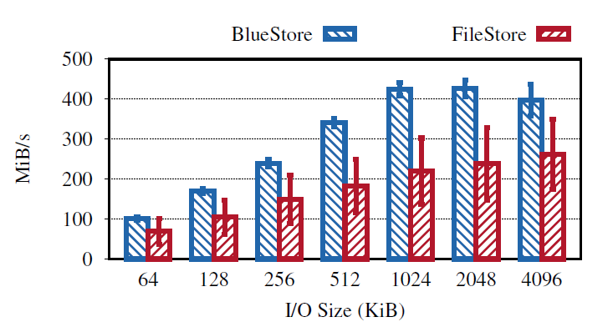
3. Evaluation
compare the throughput of object writes to the RADOS distributed object storage
Double Writes
consistency overhead

Slide 15
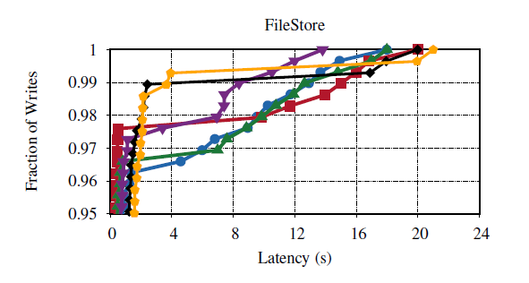
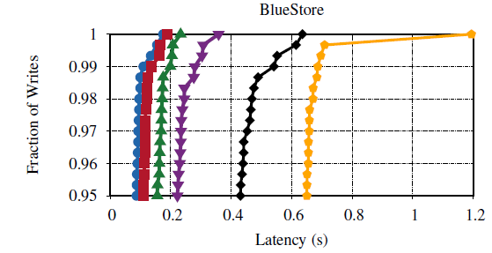

3. Evaluation
compare the throughput of object writes to the RADOS distributed object storage
95th and above percentile latencies of object writes to RADOS

Slide 16
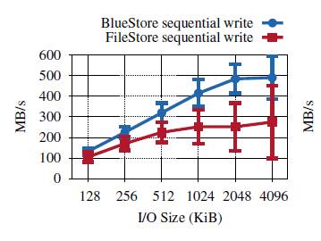
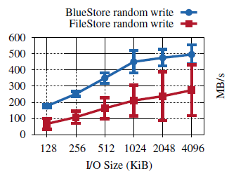
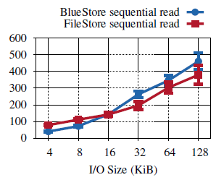
3. Evaluation
End-to-end throughput of random writes, sequential writes, and sequential reads to RBD, the Ceph virtual block device built on RADOS
Writeback conflicts
kernel readahead

Slide 17
4. Challenge
Cache sizing
Key value store efficiency
Cpu and memory efficiency
Support For New Storage Hardware

Slide 18
5. Conclusion
Bluestore is better than filestore but steal have a challenge

Slide 19
Thank You!
2021. 02. 02

